Slide 1
Software Engineering – Final Design
Team Plan B
Austin Dionne
Greg Hovagim
Carlos Lazo
Nathan Soule

Slide 2
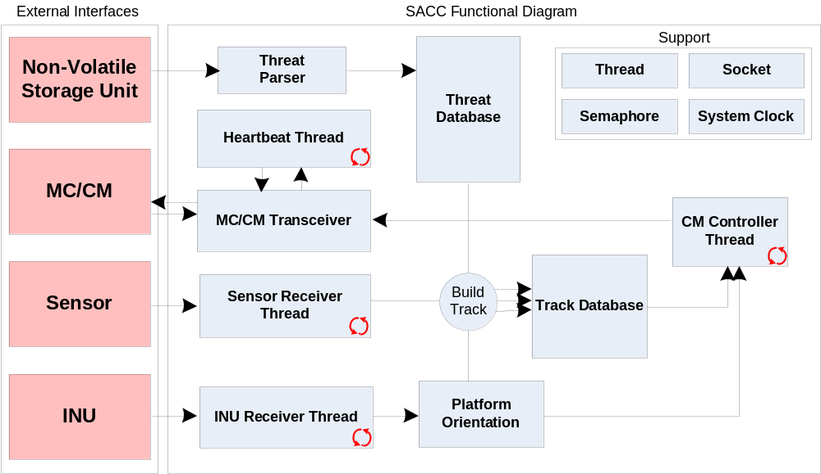
Block Diagram

Slide 3
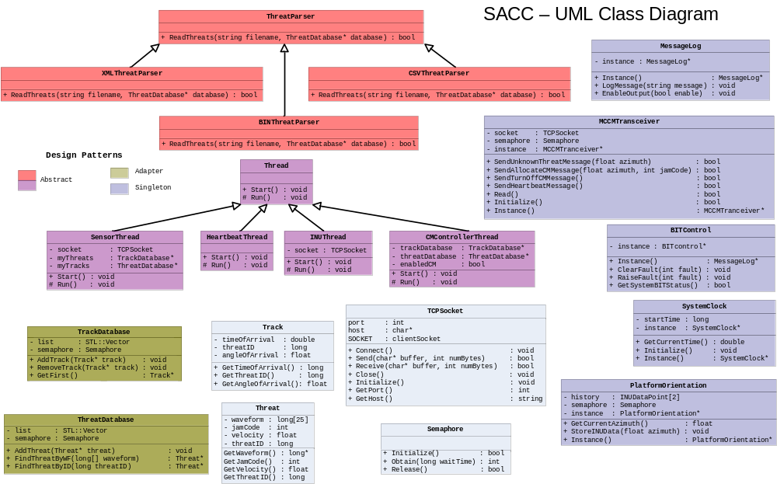
Class Diagram

Slide 4
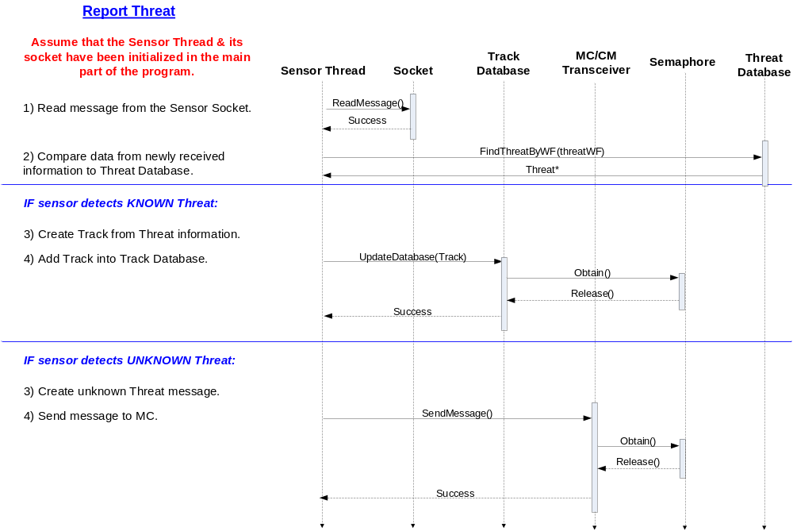

Slide 5
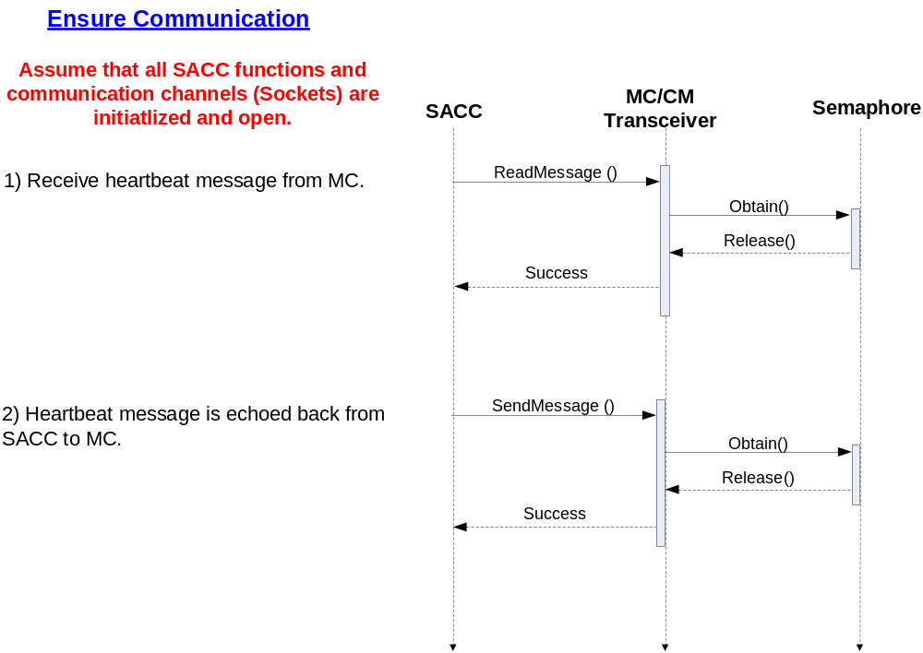

Slide 6
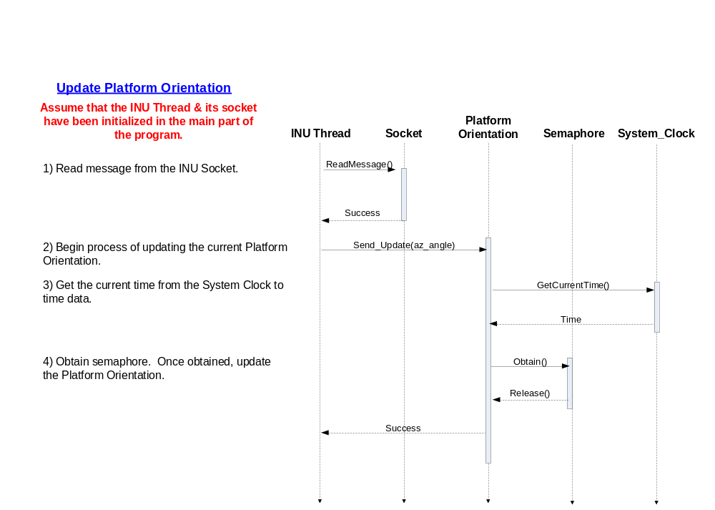

Slide 7
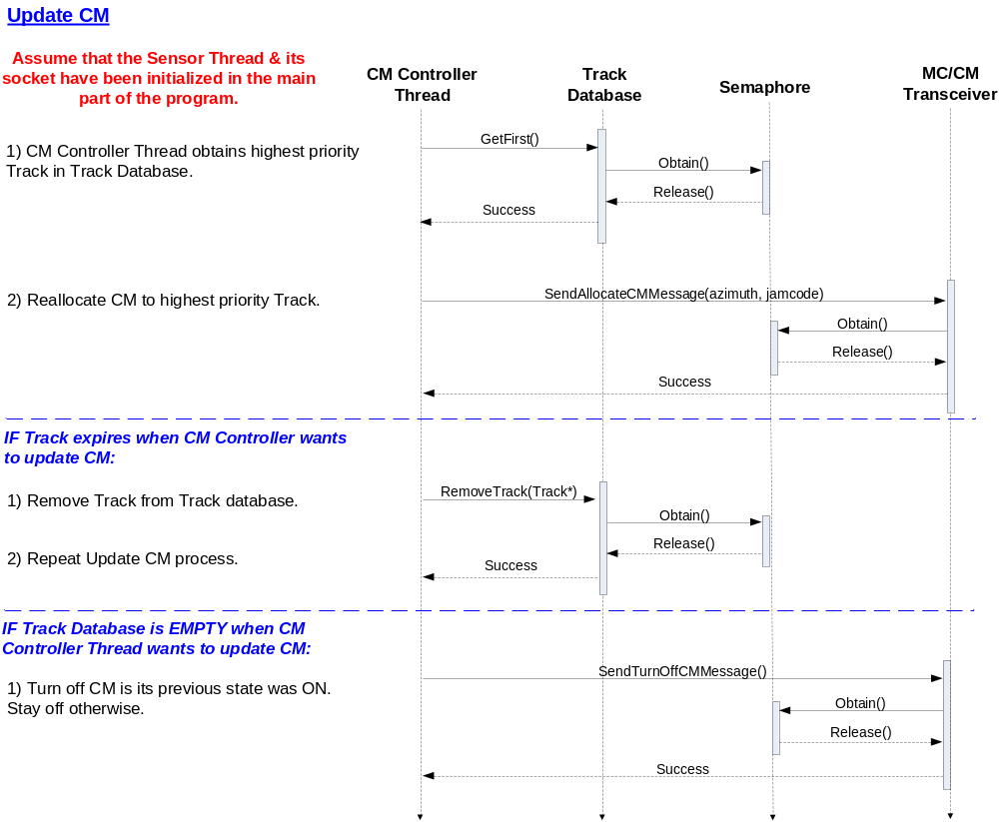

Slide 8
Lines of Code
 | Lines of Code | LOC/Day | Hours of Coding
Estimated | 790 | 25 | 253
Actual | 697 | 34 | 164
Risk: If the design “decisions” didn’t work
Avoided, no serious changes were needed thanks to well thought out preliminary design
Risk: Trouble meeting real-time deadlines due to target OS
Avoided, threats were successfully defeated in real time on target OS
Opportunity: Utilize standard template library classes to implement data storage
Successful, STL library was used and saved a substantial amount of time
Opportunity: Contract engineer with expertise in Windows development
Unsuccessful, a windows development expert was not utilized.

Slide 9
Coding Process - Iterative
Iterative Design
Easily divided the work to be done
Allowed checks of each class as they were completed
Flexibly adapted to changes in requirements
Split up multi-threading tasks, etc.

Slide 10
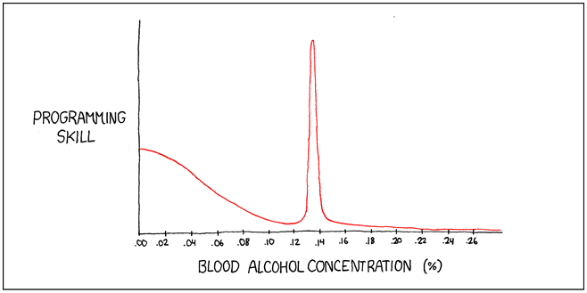
Lessons Learned
Don’t work with 2 software engineers
They will bicker over format issues…FormatIssues…Format_Issues…formatIssues ???
It is ok to be ambitious if you have the necessary resources and are willing to put in the time
There is a lot more to a successful software project then the written code.
If you only have 2 errors on the first build, its likely that fixing one of those errors will result in 19
New errors.
STL is very handy, mainly vector and string
Extremely helpful to build a little test a little
Ballmer’s peak is key

Slide 11
Demonstration

Slide 12


Questions?

